Slide 1
A Tour to Statistically Informed Interactive Maps
Researcher: Carina Zheng
Supervisor: Richard Penny
With Statistics NZ
Notes:
Statistics NZ is attempting to provide a better way to display the information to users. Because the technology is getting more advanced day-by-day and the internet is commonly used now, we are planning to display the result in an interactive manner. Our first step is to compare different interactive plots to find out what the good and bad components of interactive plots. Doing this, we can make sure our future plots are suitable for publishing and easy to use for users.

Slide 2
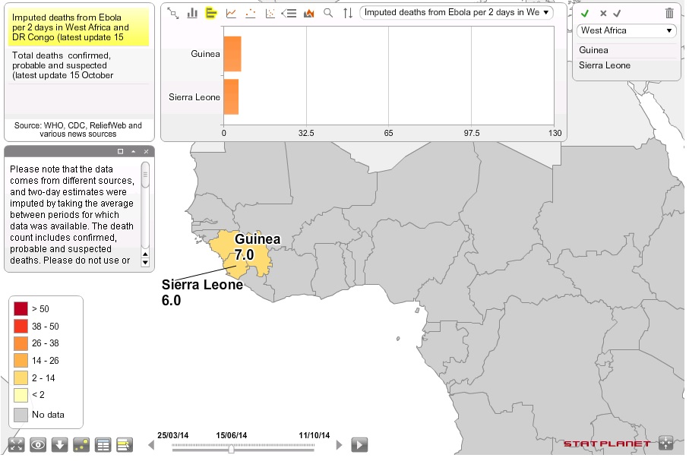
What we got
Outline
What we got
What we
have done
About this map, I think…
Good ☺
Many functions
Explanations and notes are available
Fancy looking
Bad ☹
Too much on one page
Top panel blocks part of the map
What do you think?
How to make a good statistical interactive map?
After browsing website and practices…
Notes:
We have browsed many different types of interactive websites, and we are using this specific one from StatSilk as an example. There’s no doubt that this is a fancy interactive plot, however, it is a bit to confusing to general audience in my opinion because…

Slide 3
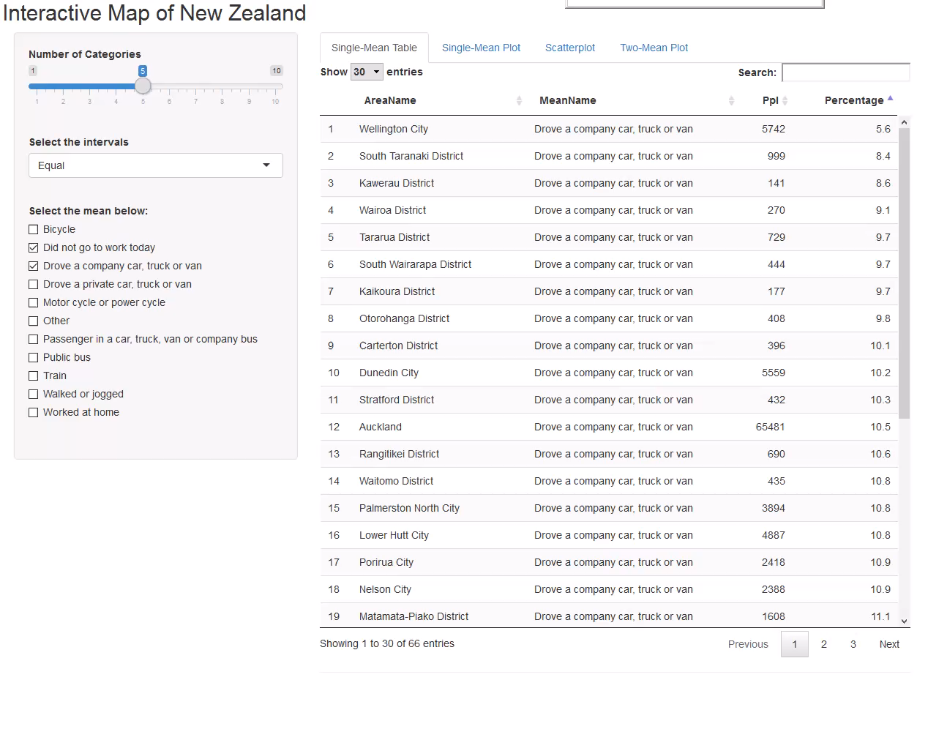
What we have done
Outline
What we got
What we
have done
In this project, we have…
The parameter selections – for customisation purpose.
A scatterplot for comparing two travel means within territory authorities – for better result visualization to users.
Coloured map with the legend – for users to view the map in a compared manner.
Good ☺
Simple to use, not much explanation is required.
Colourful (YAY) and colour-blindness is considered.
Bad ☹
Layout isn't ideal
What do you think, any opinion?
Notes:
Some definitions
On the first tab, we have this table for last selected mean
On the second tab, we have the coloured map for the single mean. We have
What’s being displayed – the travel means in TA

